Slide 1
Complete LangGraph Crash Course

Slide 2
Advanced
Intermediate
Basic

Slide 3
Course Overview 💬
1. Levels of Autonomy in LLM applications (Code -> LLM Call -> Chain -> Router -> Agent)
2. Understanding Agents & Tools
3. Building Agents & Tools from Scratch
4. Building Agents From pre-defined LangChain classes

Slide 4
Course Overview 💬
5. Graph Structure
- Direct Acyclic Graph (DAG) vs Cyclic Graph
6. What is LangGraph?
7. Why LangGraph is required?
8. Creating LangGraph from scratch
9. Creating a LangGraph using in-built classes (Reflection, Reflexion agents, etc.)
10. Key concepts and terms in LangGraph
- Graph, state, nodes, edges, visualisation, checkpoints, breakpoints, configuration

Slide 5
Course Overview 💬
11. Creating a Chatbot with LangGraph
12. Common Agentic Patterns
- Human-in-the-loop
- ReAct Agent, and many more.
13. Multi-agent systems using LangGraph
14. RAGs with LangGraph: CRAG vs ARAG vs self-RAG
15. Persistence

Slide 6
Course Overview 💬
16. LangGraph ecosystem
- LangGraph Studio
- LangGraph Cloud API, etc
17. Agents in Production

Slide 7
Pre-requisites
1. You need to have Python 3.8 or higher installed
2. LangChain (as LangGraph builds on top of LangChain)

Slide 8
Levels of Autonomy in LLM applications
1. Code
Code has zero autonomy and is 100% deterministic
We all know that everything is hard-coded and it is not even really a cognitive architecture.
Disadvantage:
The problem? You'd need to write rules for every possible scenario - making it impossible to handle real-world complexity.

Slide 9
Levels of Autonomy in LLM applications
2. LLM call
A single LLM call means your app basically does one main thing - you give it an input, it processes it, and gives you back an output.
Think of chatbots that just take your message and respond, or apps that translate text.
This was a huge leap from hard-coded rules, even though it's still pretty simple and is only in the 2nd stage of autonomy

Slide 10
Levels of Autonomy in LLM applications
2. LLM call
User Input
LLM
Output
Example User Input: You are an expert LinkedIn post writer. Write me a post on "AI Agents Taking over Content Creation"

Slide 11
Levels of Autonomy in LLM applications
2. LLM call
A single LLM call means your app basically does one main thing - you give it an input, it processes it, and gives you back an output.
Think of chatbots that just take your message and respond, or apps that translate text.
This was a huge leap from hard-coded rules, even though it's still pretty simple and is only in the 2nd stage of autonomy
Disadvantage:
Trying to get everything done in one shot often leads to confused or mixed-up responses - just like how a single person can't be an expert at everything.

Slide 12
Levels of Autonomy in LLM applications
3. Chains
Think of chains like having multiple specialists instead of one generalist. Instead of asking one AI to do everything, we break it down into steps where each AI is really good at one thing.
Imagine a customer service chatbot: The first AI reads your complaint and figures out exactly what product you're talking about
The second AI finds the right solution from the company's help docs, and the third AI turns that solution into a friendly response.
Each step is simple, but together they create a much smarter system than a single LLM call could.

Slide 13
Levels of Autonomy in LLM applications
3. Chains (contd.)
This is where we first started seeing AI apps that could handle more complex tasks - not just by being smarter, but by breaking big problems into smaller, manageable pieces.
Disadvantage:
The downside? These fixed sequences are like a rigid assembly line - they always follow the same steps defined by the human.

Slide 14
Levels of Autonomy in LLM applications
3. Chains (contd.)
Prompt template {title}
LLM
Output
LinkedIn
Post title
Twitter
Prompt template {title}
Output
LLM
Blog post
Prompt template {title}
LLM
Output
Example User Input: "AI Agents taking over Content Creation"

Slide 15
Levels of Autonomy in LLM applications
4. Router
Now this is where it gets interesting - routers are like smart traffic cops for your AI. Instead of having a fixed path like in chains, the AI itself decides what steps to take next.
Imagine a personal assistant bot: when you ask it something, it first figures out if you need help with scheduling, research, or calculations, then routes your request to the right tool or chain for the job.

Slide 16
Levels of Autonomy in LLM applications
4. Router
LinkedIn chain
Prompt template {title}
LLM
Output
Twitter chain
User input
Router LLM
Input
Classifier
Prompt template {title}
Output
LLM
Blog post chain
Example User Input: Write me a LinkedIn post on "AI Agents Taking over Content Creation"
Prompt template {title}
LLM
Output

Slide 17
Levels of Autonomy in LLM applications
4. Router
Now this is where it gets interesting - routers are like smart traffic cops for your AI. Instead of having a fixed path like in chains, the AI itself decides what steps to take next.
Imagine a personal assistant bot: when you ask it something, it first figures out if you need help with scheduling, research, or calculations, then routes your request to the right tool or chain for the job.
Disadvantage:
While it can choose different paths, it still can't remember previous conversations or learn from mistakes.

Slide 18
Levels of Autonomy in LLM applications
5. State Machine (Agent)
This is combining the previous level (router) but with loops.
Agent ~= control flow controlled by an LLM
This involves features like:
1. Ability to have human-in-loop, ask for approval before moving on
2. Multi-agent systems
3. Advanced memory management
4. Go back in history and explore better alternate paths
5. Adaptive Learning
And many more, and THIS is where LangGraph comes into the picture

Slide 19
Levels of Autonomy in LLM applications
5. State Machine
Approval Step
LinkedIn Script writer agent
User input
Head of Content Agent
Blog Post
Writer agent
Tool 1
Example User Input: Write me a LinkedIn post on "AI Agents Taking over Content Creation"
Social Media Publisher agent
Tool 2
Tool 3

Slide 20
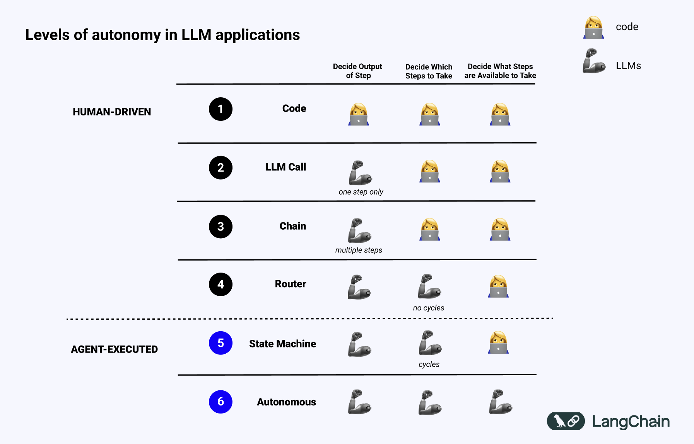

Slide 21
Levels of Autonomy in LLM applications
Chain/Router vs Agent
A Chain or even a router is one directional. Hence, it is not an agent
Whereas in a state machine, we can go back in the chain, have cycles and the flow is controlled by the LLM, hence it is called an Agent

Slide 22
Understanding AI Agents

Slide 23
AI Agents & Tools
Think of Agents as the "problem-solvers" of the AI world. Agents are capable of thinking on their own.
In other words, it's AI that can make autonomous decisions.
In the case of Chains and Router, they follow our specific instruction.
But with agents, they actually take it a step further. They can decide for themselves what steps to take on their own.

Slide 24
AI Agents & Tools
What are tools then?
Tools are specific functions that Agents can use to complete tasks
Just like a chef's kitchen tools (knife for cutting, oven for baking, blender for mixing), tools are the special abilities we give to AI - like giving it a calculator tool, or a search engine tool, or a calendar tool

Slide 25
AI Agents & Tools (Re-Act Agent Pattern)
This is one of the best known patterns in AI today to build agents. It stands for Reasoning + Acting
This is basically a concept that mimics how human beings think.

Slide 26

ReACT pattern
Think: LLM first thinks about the user prompt/problem
Action: LLM decides if it can answer by itself or if it should use a tool
Action Input: LLM provides the input argument for the tool
Here, langChain executes the tool and returns the output to the LLM
Observe: LLM observe the result of the tool
Final Answer: "This is your final answer"

Slide 27



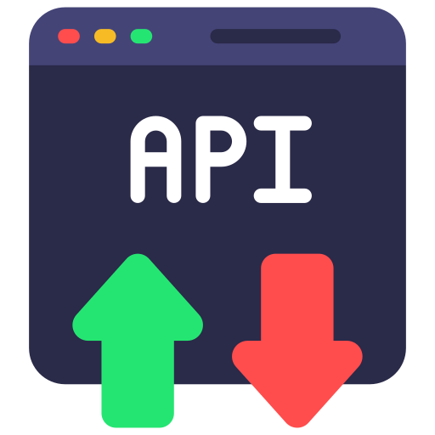

ReACT pattern
Re-Act Agent
Tools
LLM

Slide 28
Let's Jump Into The Code
1. Build a Re-act Agent Using LangChain
2. What are its drawbacks and where does LangGraph come into the picture?

Slide 29

ReAct Agents
ReAct Agents Are Flexible. i.e., Any state is possible
tool 1
Start
End
tool 2
Start
End
tool 1
tool 2
Start
End
tool 2
tool 1
Start
End

Slide 30
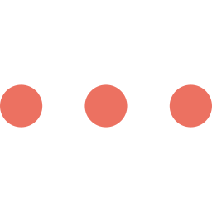

ReAct Agents
But high flexibility can also mean less reliability
tool 1
tool 1
tool 1
tool 1
Start
Infinite Loop causes:
1. We did not define the tools correctly
2. The LLM is not capable enough
3. The prompting doesn't define a clear end condition

Slide 31

Best Of Both Worlds
Chain
React Agent
tool 1
tool 2
Start
End
Tools
LLM
Not Flexible
Flexible &
Flexible
More Reliable
Reliable
Less Reliable

Slide 32

Best Of Both Worlds
Chain
LangGraph
React Agent
tool 1
tool 2
Start
End
Tools
LLM
Not Flexible
Flexible &
Flexible
More Reliable
Reliable
Less Reliable

Slide 34
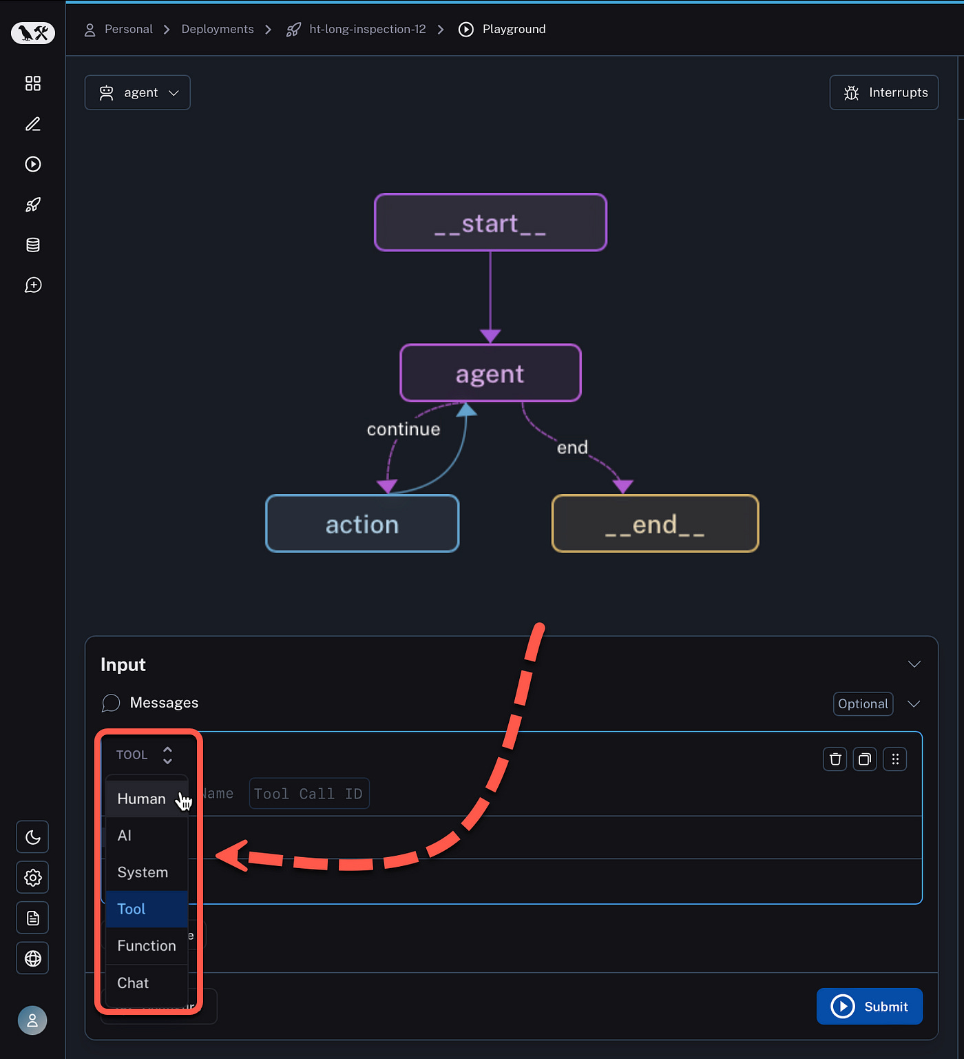
What is LangGraph?
A framework for building controllable, persistent agent workflows with built-in support for human interaction, streaming, and state management.
It uses the Graph Data Structure to achieve this

Slide 35
Key Features Of LangGraph
1. Looping and Branching Capabilities:
Supports conditional statements and loop structures, allowing dynamic execution paths based on state.
2. State Persistence:
Automatically saves and manages state, supporting pause and resume for long-running conversations.
3. Human-Machine Interaction Support:
Allows inserting human review during execution, supporting state editing and modification with flexible interaction control mechanisms.

Slide 36
Key Features Of LangGraph
4. Streaming Processing:
Supports streaming output and real-time feedback on execution status to enhance user experience.
5. Seamless Integration with LangChain:
Reuses existing LangChain components, supports LCEL expressions, and offers rich tool and model support.

Slide 37
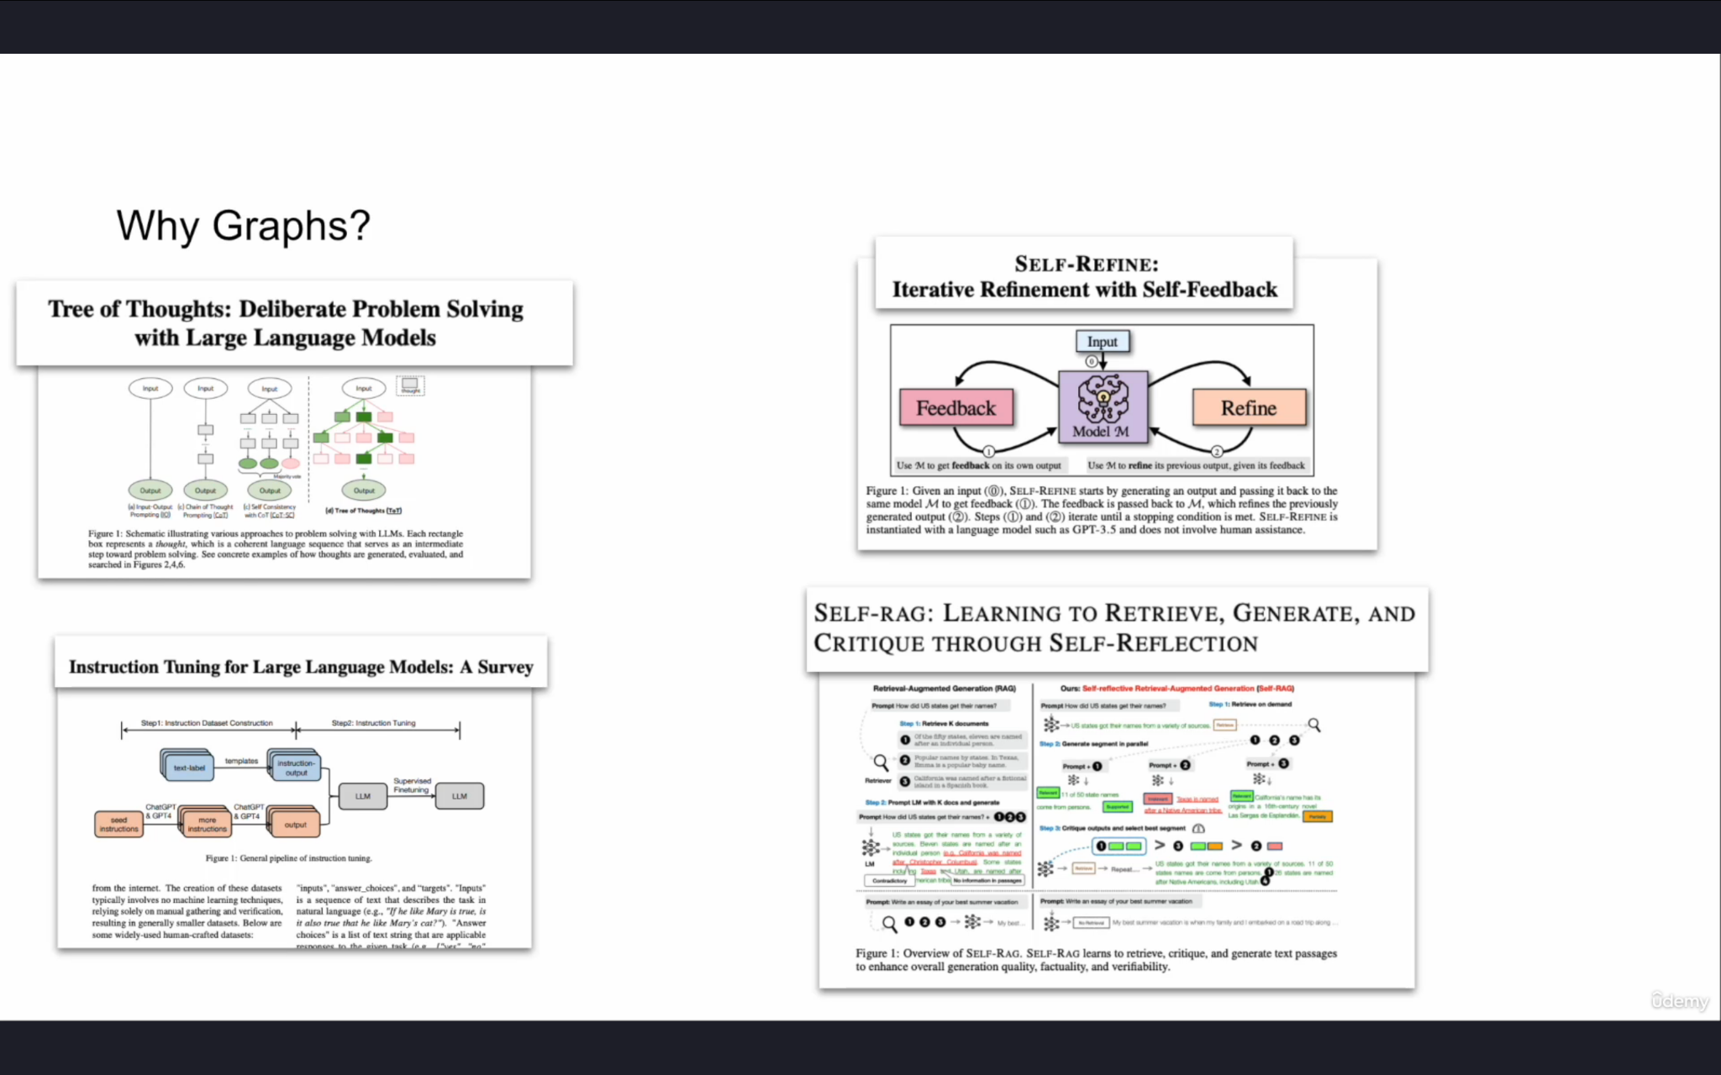
Why use the Graph Data Structure?

Slide 38
Core Components of LangGraph

Slide 39
Core Components of LangGraph
1. Nodes
2. Edges
3. Conditional Edges
4. State

Slide 40
Example: Reflection Agent pattern
_start_
Generate tweet LLM
Criticize tweet LLM
_END_

Slide 41
Reflection Agents in LangGraph

Slide 42
Reflection Agents in LangGraph
1. What is a Reflection Agent System?
2. Three types of Reflection Agent Systems
3. Setup & Installations
4. Implement a reflection Agent System

Slide 43
Reflection Agent pattern in LangGraph
But what does the English word "reflection" mean?
Like how you're looking at your reflection in the mirror, reflection means looking at yourself or your actions
For example:
- After giving a presentation, thinking about how it went
- After writing an email, reading it again to check if it's clear
- After making a decision, considering if it was the right choice

Slide 44
Reflection Agent pattern in LangGraph
So what is a reflection-agent pattern?
A reflection agent pattern is an AI system pattern that can look at its own outputs and think about them/make it better - just like how we look at ourselves in a mirror and self-reflect, make ourselves better
A basic reflection agent system typically consists of:
1. A generator agent
2. A reflector agent

Slide 45
Example: Basic Reflection Agent pattern
_start_
Tweet generation agent
Tweet critique agent
_END_

Slide 46
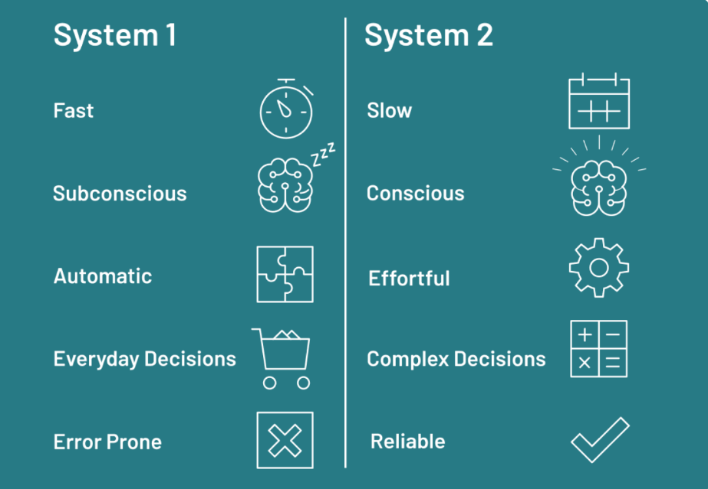
Reflection Agent pattern in LangGraph

Slide 47
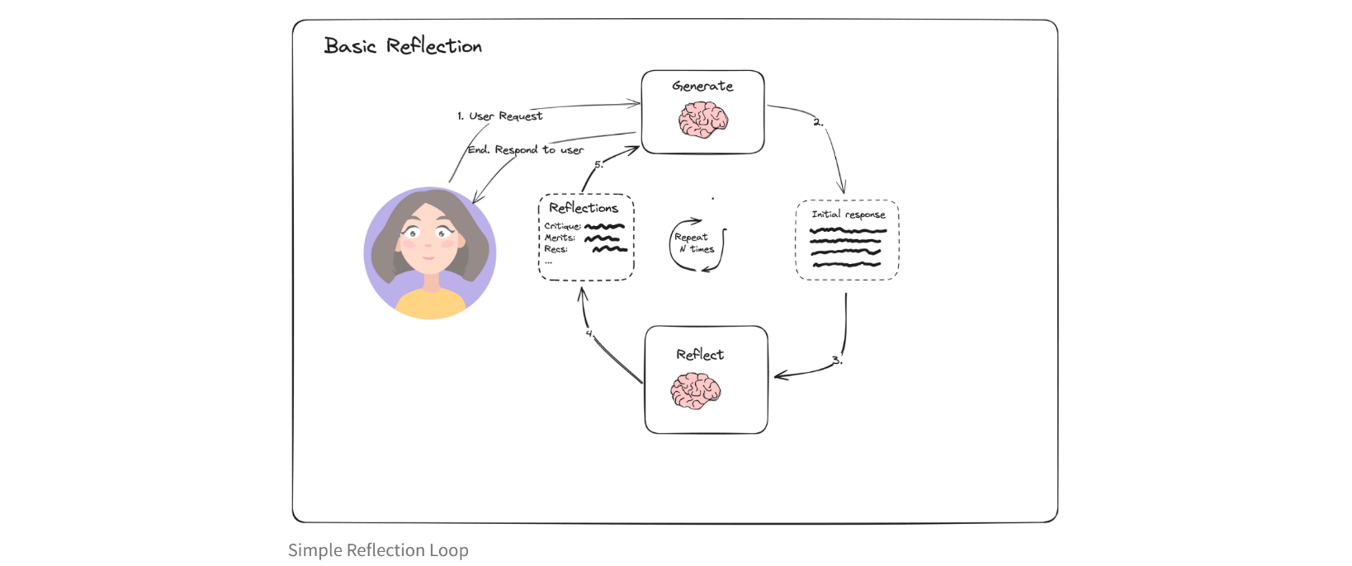

Slide 48
Types of Reflection Agents in LangGraph
There are 3 types:
1. Basic Reflection Agents
2. Reflexion Agents
3. Language Agent Tree Search (LATS)

Slide 49
Let's Implement a Basic Reflection Agent!

Slide 50
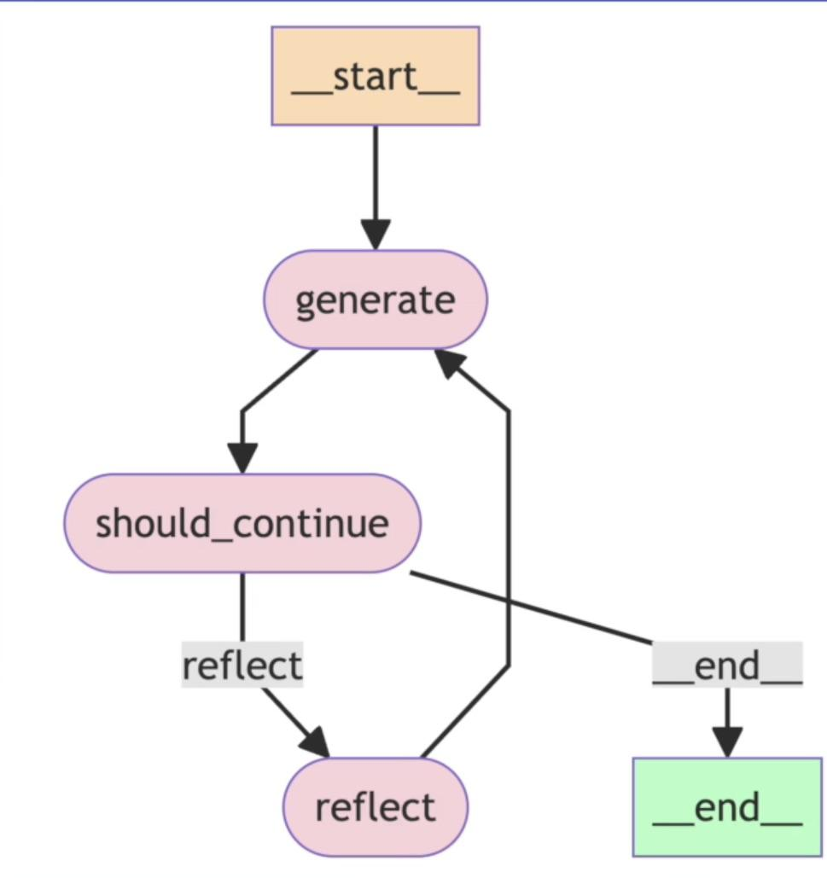
Let's Implement a Basic Reflection Agent!
In this section, we'll build:
1. generation_chain
2. reflect_chain

Slide 51
Basic Reflection Agent!
What is a MessageGraph?
It is a class that LangGraph provides that we can use to orchestrate the flow of messages between different nodes
Example use cases: Simple routing decisions, simple chatbot conversation flow
If you just want to pass messages along between nodes, then go for MessageGraph
If the app requires complex state management, we have StateGraph (more on this later)

Slide 52
Basic Reflection Agent!
What is a MessageGraph?
To put it simply, MessageGraph maintains a list of messages and decides the flow of those messages between nodes
Every node in MessageGraph receives the full list of previous messages as input
Each node can append new messages to the list and return it
The updated message list is then passed to the next node

Slide 53
Reflexion Agent System

Slide 54
Reflexion Agents in LangGraph
Recap of what we saw previously:
Reflection Agent System consists of a generator and a reflector component
Although, iteratively making a post better is significantly better than just prompting ChatGPT, the content generated is still not grounded in live data
It could be hallucination or outdated content and we have no way of knowing
Reflexion Agent System address this exact drawback

Slide 55
Reflexion Agents in LangGraph
What is Reflexion Agent System:
The reflexion agent, similar to reflection agent, not only critiques it's own responses but also fact checks it with external data by making API calls (Internet Search)
In the Reflection agent pattern, we had to rely on the training data of LLMs but in this case, we're not limited to that.

Slide 56
Reflexion Agents in LangGraph
What is Reflexion Agent System:
The main component of Reflexion Agent System is the "actor"
The "actor" is the main agent that drives everything - it reflects on it's responses and re-executes.
It can do this with or without tools to improve based on self-critique that is grounded in external data
It's main sub-components include:
1. Tools/tool execution
2. Initial responder: generate an initial response & self-reflection
3. Revisor: re-respond & reflect based on previous reflections

Slide 57
Reflexion Agents in LangGraph
Episodic memory
In the context of Reflexion agents, episodic memory refers to an agent's ability to recall specific past interactions, events, or experiences, rather than just generalized knowledge.
This is crucial for making agents feel more context-aware, personalized, and human-like over time.

Slide 58
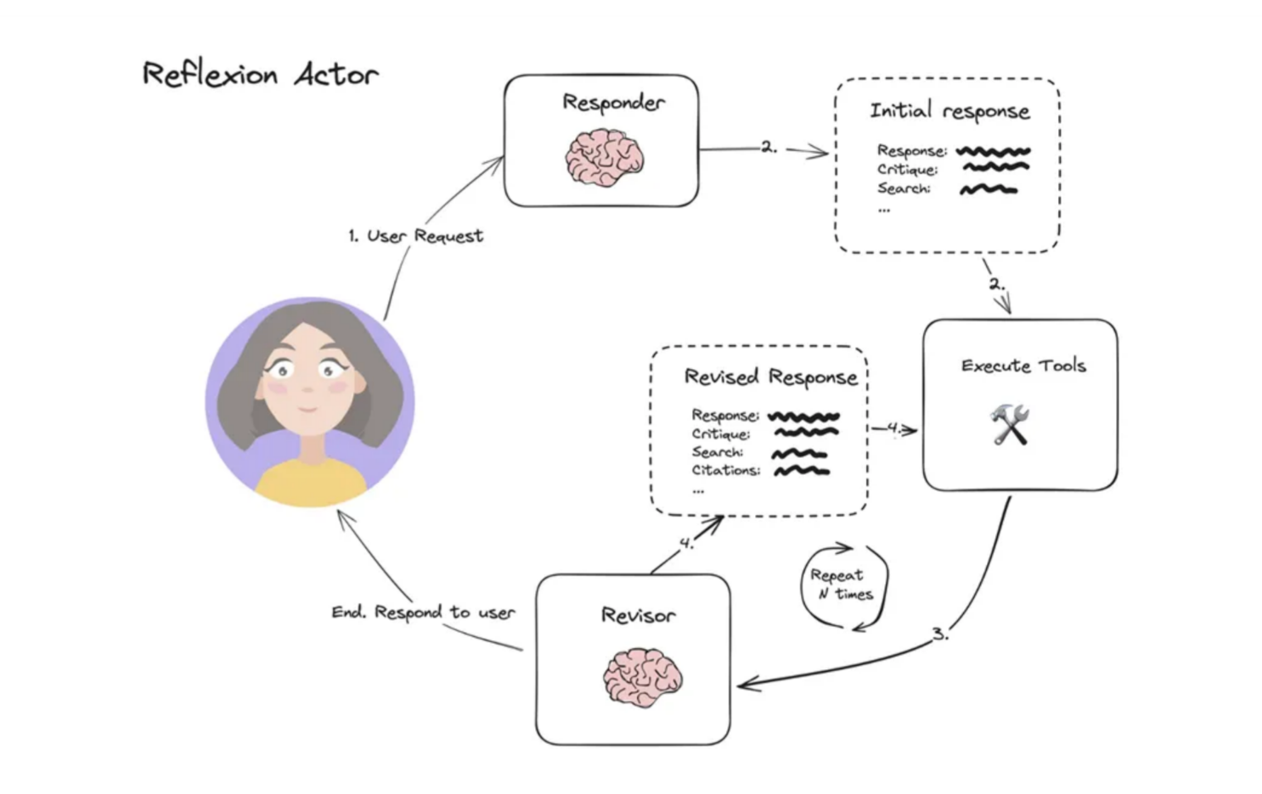
Reflexion Agent System

Slide 59
Let's Implement a Reflexion Agent!

Slide 60
LLM Response Parser System
The system converts unstructured LLM outputs into well-defined Python objects through a series of structured parsing steps, ensuring data validation and consistent formatting.
What are the key components?
1. Chat Prompt Template
2. Function Calling with Pydantic Schema
3. Pydantic Parser

Slide 61
LLM Response Parser System
2. Function Calling with Pydantic Schema
Function calling:
Similar to how we make tools available to the LLM, we can also send a schema to the LLM and force it to structure it's JSON output according to the schema
Pydantic:
A Python library that defines data structures using classes
Provides automatic validation of JSON data against these class definitions

Slide 62
LLM Response Parser System
3. Pydantic Parser
Takes the JSON output from the LLM's function call
Validates it against the defined Pydantic schema (class definition)
Creates instances of Pydantic classes with the validated data
If the LLMs output does not match with the defined schema, it will throw an error

Slide 63
Re-Act Agent using LangGraph

Slide 64
Re-Act Agent using LangGraph
Think: LLM first thinks about the user prompt/problem
Action: LLM decides if it can answer by itself or if it should use a tool
Action Input: LLM provides the input argument for the tool
Here, langChain executes the tool and returns the output to the LLM
Observe: LLM observe the result of the tool
Final Answer: "This is your final answer"

Slide 65
ReAct Agent
LangChain:
In LangChain, we used initialize_agent as an all-in-one solution.
It combines two key components:
1. create_react_agent
2. AgentExecutor (We will eliminate the need for this in LangGraph)

Slide 66
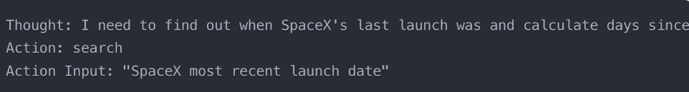
ReAct Agent
1. create_react_agent: (one that creates the agent)
Takes each tool's name and description
Formats them into a standardized way the LLM can understand
Inserts them into specific placeholders in the ReAct prompt template
It makes the LLM call + takes the LLMs response + parses it
It parses the response of the LLM into one of these two classes: AgentAction or AgentFinish

Slide 67
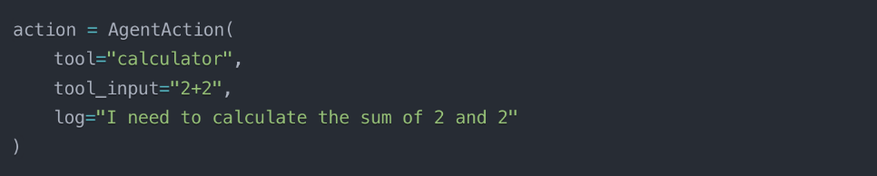
Re-Act Agent using LangGraph
AgentAction:
This is a LangChain class that represents an action the agent wants to take. It typically contains:

Slide 68
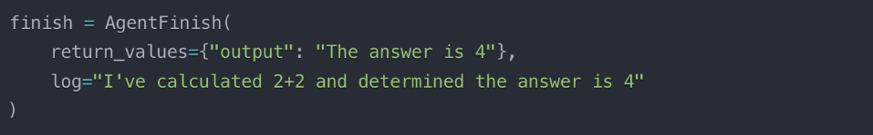
Re-Act Agent using LangGraph
AgentFinish:
This represents the agent completing its task with a final answer. It typically contains:

Slide 69
ReAct Agent
2. AgentExecutor:
Takes the agent from create_react_agent and manages the execution loop
Receives the user's question and feeds it to the agent
Identifies which tool to run based on the agent's output (AgentAction or No tool if AgentFinish)
Executes the tool and captures the result
Feeds the result back to the agent for the next decision
Continues this loop until the agent produces an AgentFinish
Returns the final answer to the user

Slide 70
ReAct Agent - LangGraph
Key Advantage:
LangGraph turns the hidden "black box" loop into a visible, editable workflow
You can now add custom nodes, modify the flow, or insert additional logic

Slide 71
Re-Act Agent using LangGraph
The "reason" node does what create_react_agent did - it thinks and decides
Start
If the reason node outputs an AgentAction, then "act" node executes the tool
Results from the tool flow back to "reason" node for the next decision
reason node
When the agent has the final answer, it takes the right path to "end"
act node
End
This visualization makes the "black box" of AgentExecutor transparent and modifiable

Slide 72
State in LangGraph - Deep Dive
What is State in LangGraph?
State in LangGraph is a way to maintain and track information as an AI system processes data.
Think of it as the system’s memory, allowing it to remember and update information as it moves through different stages of a workflow, or graph.

Slide 73
State in LangGraph - Deep Dive
Concepts we will learn:
1. What is StateGraph?
2. Basic State Structures
3. Complex State Structures
4. Manual State Transformation
5. Declarative Annotated State Transformation

Slide 74
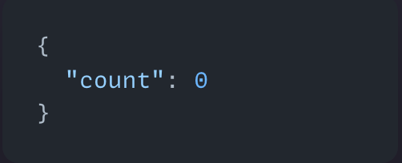
State in LangGraph - Deep Dive
1. Basic State Definition
Initial state:
Start
increment
should_continue
End

Slide 75
ReAct Agent in LangGraph - Deep Dive
States to keep track of:
1. Input that the user provided
2. The parsed output of the LLM response (AgentAction or AgentFinish)
3. The history that has taken place so far

Slide 76
Chatbots using LangGraph
What we'll cover in the next few sections:
1. Basic Chatbot (no memory)
2. Chatbot with Tools
3. Chatbot with memory
4. Chatbot with human-in-loop scenarios
5. Chatbot with more complex state
6. Understanding Time-travel

Slide 77
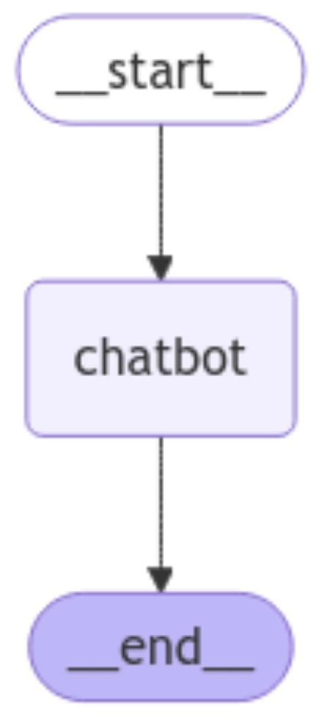
Chat bots using LangGraph
1, Basic Chatbot
- No memory
- No tools
We'll learn:
- Graph stream method
- Chat looping
- Use free Llama Model using the Groq interface

Slide 78
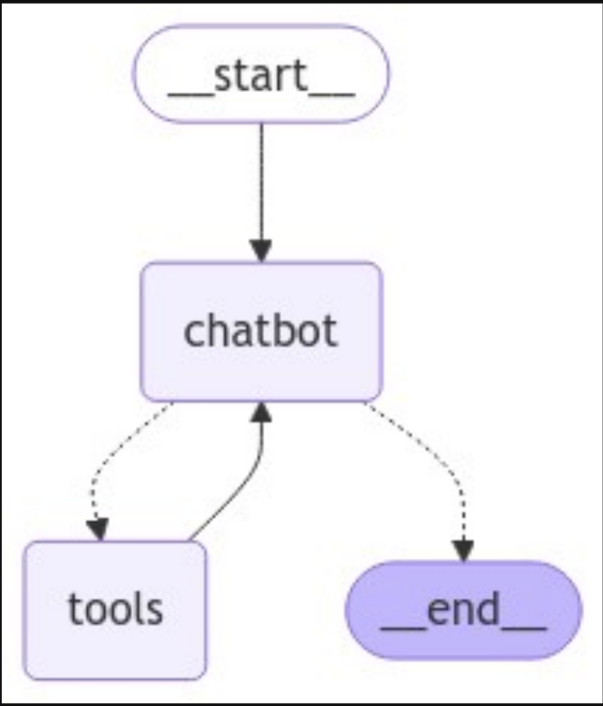
Chat bots using LangGraph
2, Chatbot with Tools
- Adding a tool call ability

Slide 79
Memory & Checkpointers
When you build a basic chatbot using LangGraph, you run into an immediate limitation: by default, your chatbot has amnesia.
Every time a user starts a conversation, the bot has no recollection of previous interactions.
This happens because without memory management, each invocation of your graph is completely independent.
This is where the concept of checkpointers in LangGraph come into the picture

Slide 80
Memory & Checkpointers
What is a Checkpointer?
A checkpointer in LangGraph is essentially a way to save the state of your agent or workflow at specific points during execution.
Think of it like saving your progress in a video game. When you reach a checkpoint:
1. The current state of everything is saved
2. If something goes wrong later, you can return to this saved point
3. You don't have to start over from the beginning

Slide 81
Memory & Checkpointers
What is a Checkpointer? (contd.)
In the context of LangGraph nodes and workflows:
Nodes are the individual steps or components in your workflow
Checkpoints save the complete state after a node finishes its work
If an error occurs in a later node, you can resume from the last checkpoint rather than starting the entire workflow again
This is particularly useful for complex workflows where:
Processing takes significant time or resources
You want to implement retry mechanisms
You need persistence across sessions or server restarts

Slide 82
Memory & Checkpointers
Thread ID:
A thread ID is simply a unique identifier for each specific conversation or workflow execution. Think of it like:
- A unique session ID for a user
- A conversation ID that groups related messages together
The thread ID is necessary because:
1. You might have multiple conversations/workflows running simultaneously
2. Each needs its own separate saved state
3. The thread ID helps the system know which saved state belongs to which conversation
Without thread IDs, all your conversations would share the same state, which would cause confusion and errors.

Slide 83
Human In The Loop
A human-in-the-loop workflow integrates human input into automated processes, allowing for decisions, validation, or corrections at key stages
This is especially useful in LLM-based applications, where the underlying model may generate occasional inaccuracies.
Use-cases:
1. Reviewing tool calls: Humans can review, edit, or approve tool calls requested by the LLM before tool execution.
2. Validating LLM outputs: Humans can review, edit, or approve content generated by the LLM
3. Providing context: Enable the LLM to explicitly request human input for clarification or additional details or to support multi-turn conversations.

Slide 84
Human In The Loop (Design Patterns)
There are typically three different actions that you can do with a human-in-the-loop workflow:
1. Approve or Reject:
Pause the graph before a critical step, such as an API call, to review and approve the action.
If the action is rejected, you can prevent the graph from executing the step, and potentially take an alternative action. This pattern often involve routing the graph based on the human's input.

Slide 85
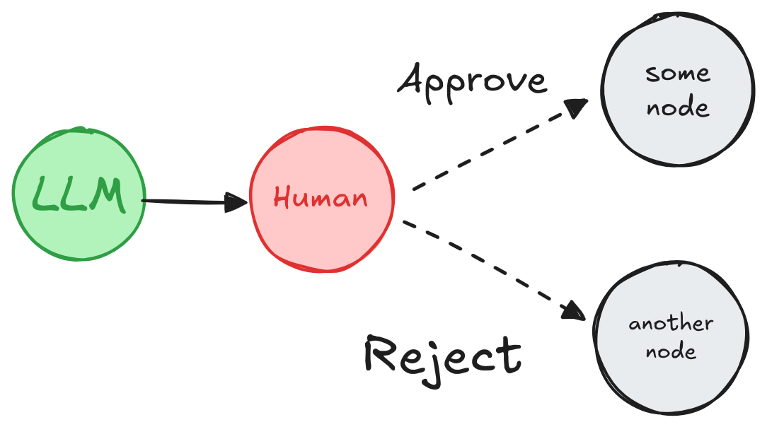
Human In The Loop (Design Patterns)
There are typically three different actions that you can do with a human-in-the-loop workflow:
1. Approve or Reject:
Depending on the human's approval or rejection, the graph can proceed with the action or take an alternative path.

Slide 86
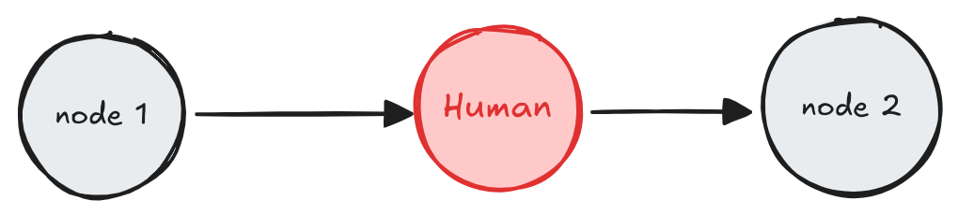
Human In The Loop (Design Patterns)
2. Review & Edit State:
A human can review and edit the state of the graph. This is useful for correcting mistakes or updating the state with additional information.

Slide 87
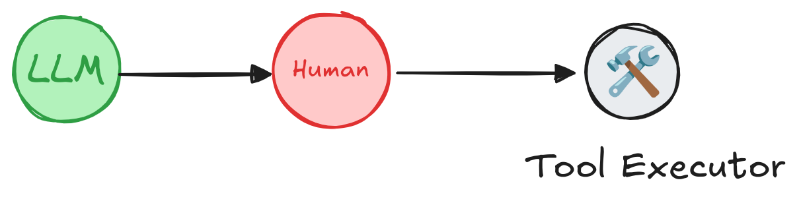
Human In The Loop (Design Patterns)
3. Review Tool Calls:
A human can review and edit the output from the LLM before proceeding.
This is particularly critical in applications where the tool calls requested by the LLM may be sensitive or require human oversight.

Slide 88
Human In The Loop (Design Patterns)
Start
generate_post
post
collect_feedback
END

Slide 89
Human In The Loop
Drawbacks of input():
Freezes your program completely until someone types something
Only works in terminals - useless for web apps
If your program crashes, all progress is lost
Can only handle one user at a time
Lives only in your terminal session
This is why we use a special method that LangGraph provides called "interrupt"

Slide 90
Human In The Loop
What is interrupt() & Why Use It?:
Special LangGraph function that pauses your workflow nicely
Saves your program's state so it can continue later
Works in web apps, APIs, and other interfaces
Handles multiple users/sessions at once
Survives program crashes and restarts
Lets humans take their time to respond
Required for any serious human-in-the-loop system

Slide 91
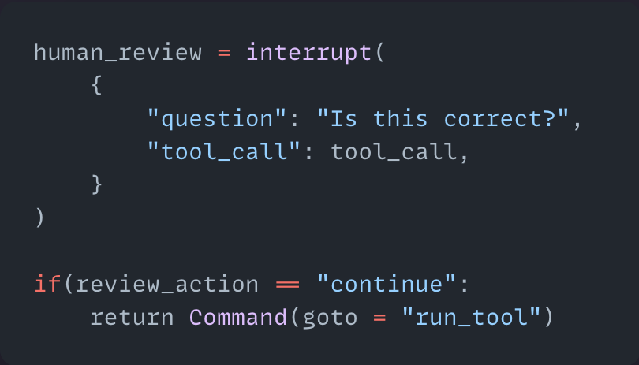
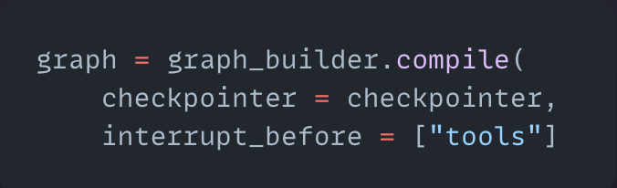
Human In The Loop
Two ways for using Interrupts:
Interrupt function with Command Class
Interrupt in the compile step

Slide 92
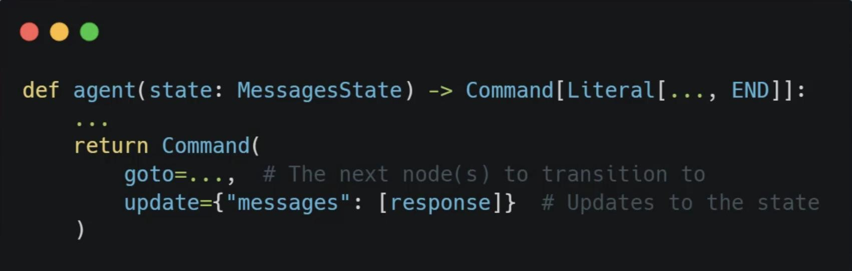
Command Class
The Command class in LangGraph allows us to create edgeless workflows

Slide 93
Command Class
START
node_a
node_b
node_c
END

Slide 94
Command Class
START
node_a
node_b
node_c
node_d
END

Slide 95
Interrupts
Operations with Interrupts:
1. Resume - Continue execution with input from the user without modifying the state
2. Update and Resume - Update the state and then continue execution
3. Rewind/time Travel - Go back to a previous checkpoint in the execution
4. Branch - Create a new branch from the current execution state to explore alternative paths
5. Abort - Cancel the current execution entirely
Each of these operations gives you different ways to control the flow of your graph when it's interrupted

Slide 96
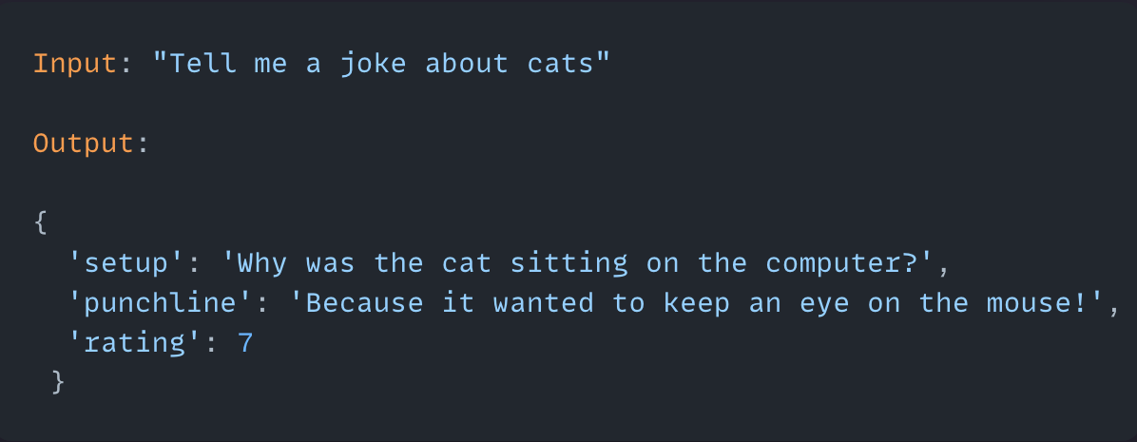
Structured Outputs
It is often useful to have a model return output that matches a specific schema that we define
We have options to get outputs in formats such as - JSON, Dictionary, string, YAML, HTML

Slide 97
Structured Outputs
Pydantic Models for Structured Outputs:
1. Pydantic is a Python library that helps define data structures
2. Acts like a "blueprint" for data
3. Uses Python's type hints (like str, int) to enforce correct data types
How it works in LangChain/LangGraph:
1. Define a class with the fields you need (name, capital, language)
2. Add descriptions to explain what each field means
3. Use with_structured_output() to tell the LLM to follow your format

Slide 98


Retrieval Augmented Generation (RAG) System
1. Knowledge-base construction:
[1, 0 ,1, 0, 0]
Chunk
Source Documents
(~1M tokens)
Chunking
(~1K tokens)
Chunk
[1, 0 ,1, 0, 0]
Vector DB
Chunk
[1, 0 ,1, 0, 0]
2. Query Processing:
LLM
Chunk
"""
Chunk 1 Text
Chunk 2 Text
Chunk 3 Text
Question
"""
Query
[1, 0 ,1, 0, 0]
Retriever
Chunk
Query

Slide 99
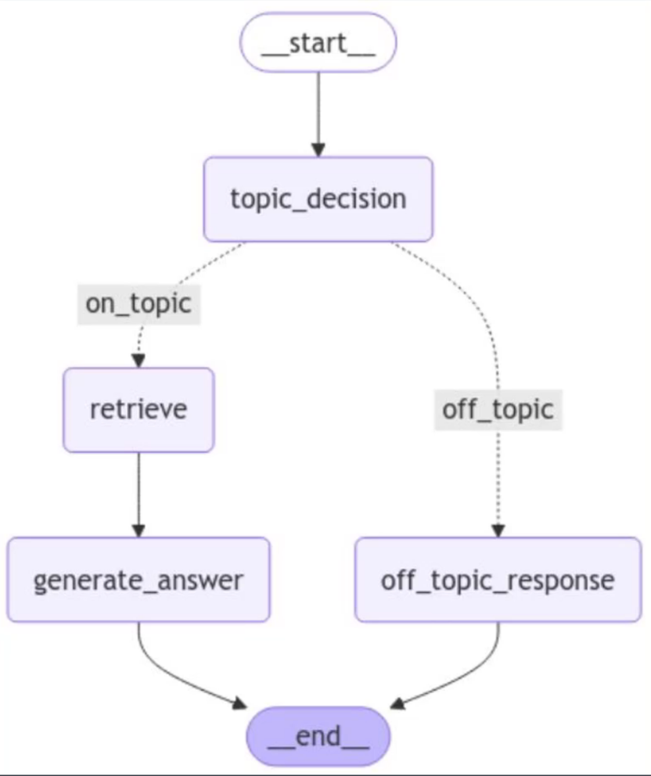
Classification-Driven Retrieval System

Slide 100
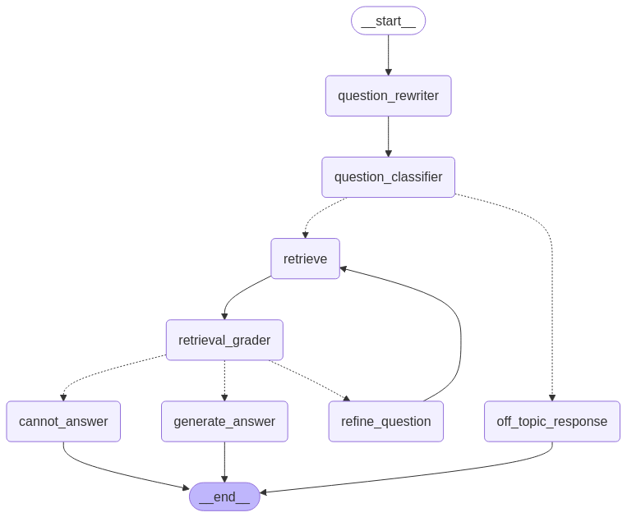
Advanced multi-step RAG System

Slide 101
Advanced multi-step RAG System
question_rewriter node significance:
Initial query: "What are Peak Performance Gym's hours?"
Follow-up query: "What about weekends?"
Without rephrasing, the follow-up query lacks context on its own and would likely return irrelevant results if sent directly to a retrieval system.
The rephrasing node transforms "What about weekends?" into "What are Peak Performance Gym's weekend hours?"

Slide 102
Multi-Agent Architectures
We know that an agent is a system that uses an LLM to decide the control flow of an application.
As you develop these systems, they might grow more complex over time, making them harder to manage and scale.
For example, you might run into the following problems:
Agent has too many tools at its disposal and makes poor decisions about which tool to call next
context grows too complex for a single agent to keep track of
there is a need for multiple specialization areas in the system (e.g. planner, researcher, math expert, etc.)
To tackle these, you might consider breaking your application into multiple smaller, independent agents and composing them into a multi-agent system.

Slide 103
Multi-Agent Architectures
These independent agents can be as simple as a prompt and an LLM call, or as complex as a ReAct agent
The primary benefits of using multi-agent systems are:
Modularity: Separate agents make it easier to develop, test, and maintain agentic systems.
Specialization: You can create expert agents focused on specific domains, which helps with the overall system performance.
Control: You can explicitly control how agents communicate (as opposed to relying on function calling).

Slide 104
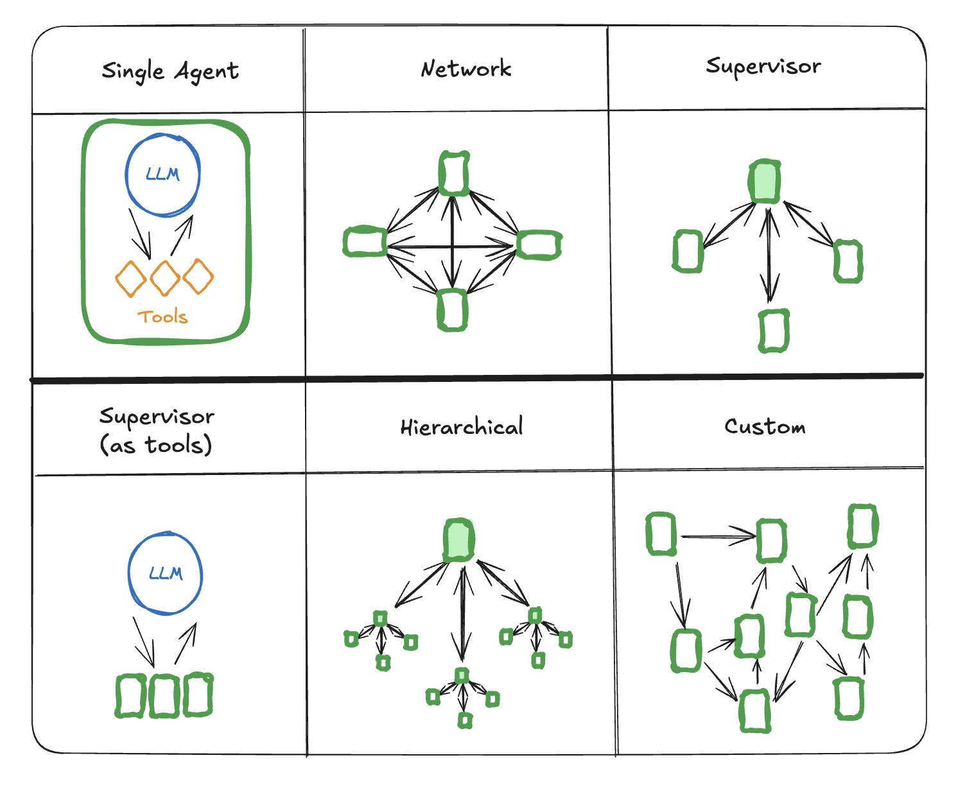
Multi-Agent Architectures

Slide 105
Subgraphs
Subgraphs allow you to build complex systems with multiple components that are themselves graphs. A common use case for using subgraphs is building multi-agent systems.
The main question when adding subgraphs is how the parent graph and subgraph communicate, i.e. how they pass the state between each other during the graph execution.
There are two scenarios:
parent graph and subgraph share schema keys. In this case, you can add a node with the compiled subgraph
parent graph and subgraph have different schemas. In this case, you have to add a node function that invokes the subgraph: this is useful when the parent graph and the subgraph have different state schemas and you need to transform state before or after calling the subgraph

Slide 106
Supervisor Multi-agent Architecture
In this architecture, we define agents as nodes and add a supervisor node (LLM) that decides which agent nodes should be called next.
We use Command to route execution to the appropriate agent node based on supervisor's decision.

Slide 107






Supervisor Multi-agent Architecture
Supervisor
User Prompt
Enhancer
Researcher
Coder
Validator

Slide 108
Streaming in LangGraph
If we're building a responsive app for the users, real-time updates are key to keeping them engaged.
Common use-cases are:
1. Workflow progress (e.g., get state updates after each graph node is executed).
2. LLM tokens as they’re generated.
3. Custom updates (e.g., "Fetched 10/100 records")

Slide 109
Streaming in LangGraph
.stream and .astream are sync and async methods for streaming back outputs from a graph run.
There are several different modes you can specify when calling these methods (e.g. `graph.stream(input, stream_mode="values")):
Most common modes are:
1. stream_mode = "values"
This streams the full value of the state after each step of the graph.
2. stream_mode = "updates"
This streams the updates to the state after each step of the graph

Slide 110
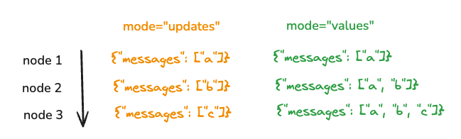
Streaming in LangGraph
stream_mode = "updates" vs stream_mode = "values"

Slide 111
Streaming in LangGraph
In prod apps, we usually want to stream more than the state.
In particular, with LLM calls it is common to stream the tokens as they are generated.
We can do this using the `.astream_events` method, which streams back events as they happen inside nodes
Each event is a dict with a few keys:
* `event`: This is the type of event that is being emitted.
* `name`: This is the name of event.
* `data`: This is the data associated with the event.
* `metadata`: Which contains `langgraph_node`, the node emitting the event.

Slide 112
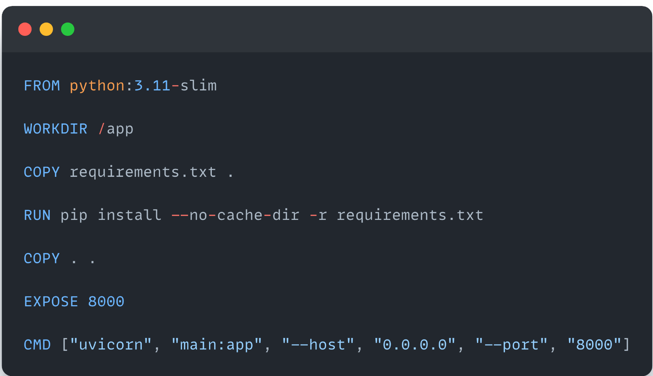
Deployment
Deployment:
So far, we have built an API around the agent
The last step is to deploy our graph using industry-standards.
The standard approach to this is using Docker containers

Slide 113
Conclusion
Self-Hosting LangGraph Agents:
TLDR: LangGraph Cloud Optional
1. Build API wrapper around your graph
2. Containerize with Docker
3. Deploy to your preferred cloud provider

